Slide 1

Change to “Innovating to drive results for every young person”

Slide 2

Please confirm the judging criteria and Timeline for Tuvalu programme.
Change to “Tuvalu Ministry of Education and Human Resources Development (MEHRD)”

Slide 3
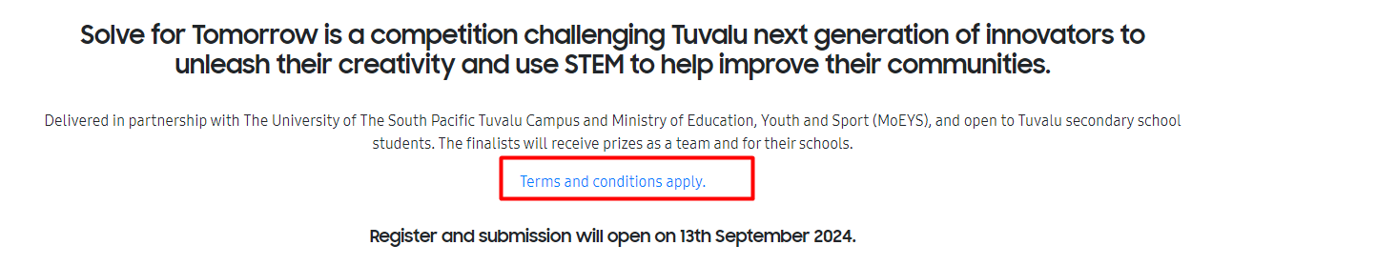
Final TnCs doc attached – pleace update the T&Cs link in the website.

Slide 4

$2900 AUD
$1700 AUD
$700 AUD

Slide 5
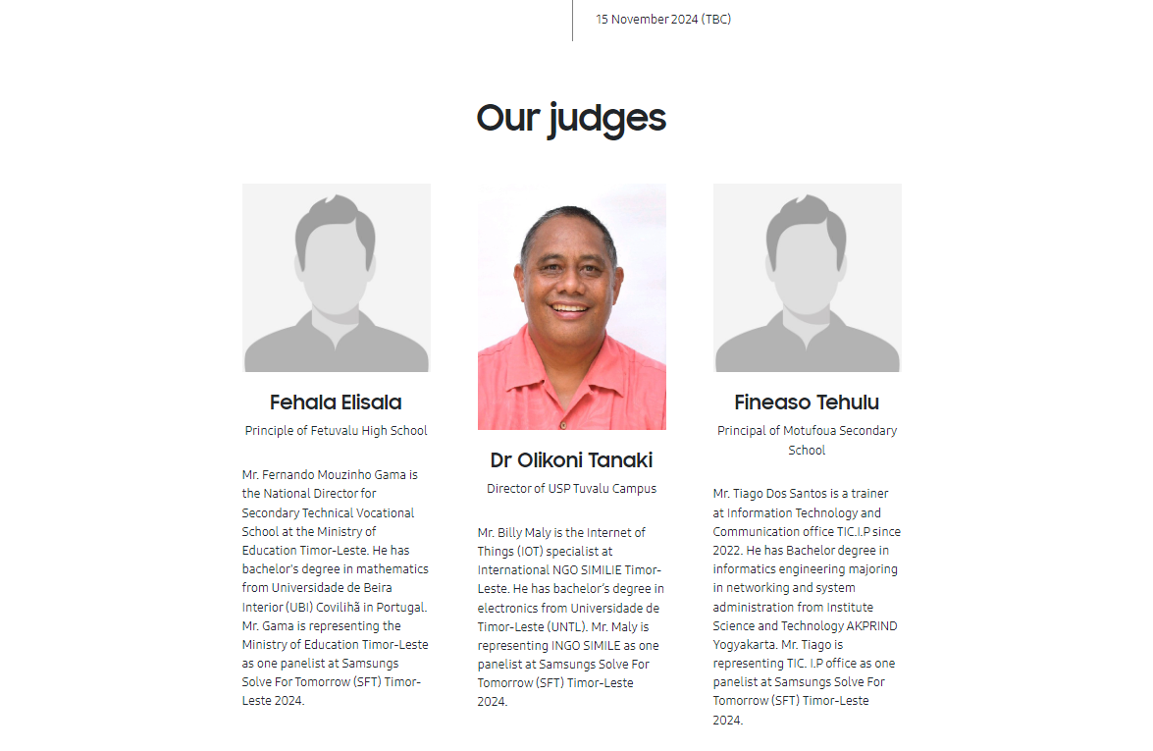
Change the order
Dr Olikoni - Fehala - Fineaso

Slide 6
Update the image & bio
(Image resized &attached )
Dr. Olikoni Tanaki Campus Director, University of the South Pacific, Tuvalu Campus
Dr. Olikoni Tanaki is the Campus Director of the University of the South Pacific's Tuvalu Campus. He holds a PhD from Massey University, specialising in educational experiences in higher learning environments. With a background in educational leadership and research, Dr. Tanaki has contributed to various consultancy projects across the Pacific, focusing on teaching quality and student outcomes. His expertise in higher education and vocational training strengthens his role as a judge for SFT program.

Slide 7
Update the image & bio
(Image attached )
Fehala Elisala Principal, Fetuvalu High School
Fehala Elisala is the Principal of Fetuvalu High School, appointed by the School’s Board of Directors and the Head Office of the Ekalesia Kelisiano o Tuvalu (EKT). With a focus on inclusive education, Mrs. Elisala is dedicated to implementing programs that cater to the diverse abilities of all students. Her leadership at Fetuvalu High School is marked by a commitment to fostering academic success and ensuring equitable opportunities for students to reach their full potential. As a SFT judge, she brings a wealth of experience in educational leadership and student development.

Slide 8
Update the image & bio
(Image attached )
Fineaso Tehulu Principal, Motufoua High School
Fineaso Tehulu is the Principal of Motufoua High School and a Gold Medal recipient at the 2024 University of the South Pacific graduation for being the most outstanding Master of Arts by Thesis students. Specialising in education and leadership, Mr. Tehulu brings a wealth of knowledge and academic expertise to his role. His dedication to academic excellence and fostering personal growth aligns with his vision to uplift the next generation of leaders in Tuvalu. As a member of the SFT judging panel, he offers a deep understanding of educational development and a commitment to nurturing talent.

Slide 9
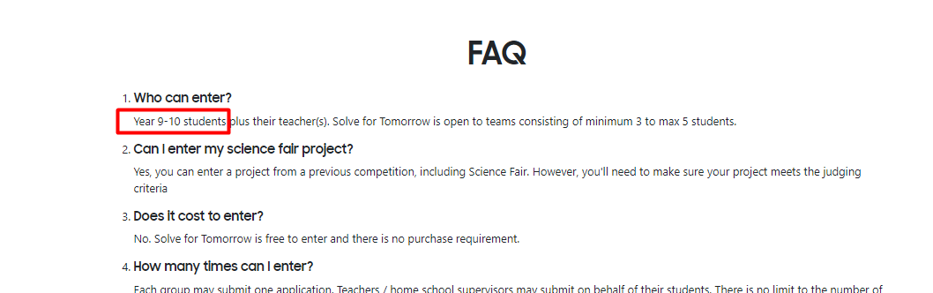
Change to “Year 10-13 students”

Slide 10
The judging panel comprises individual judges from Samsung, MEHRD, USP, and external.

Slide 11
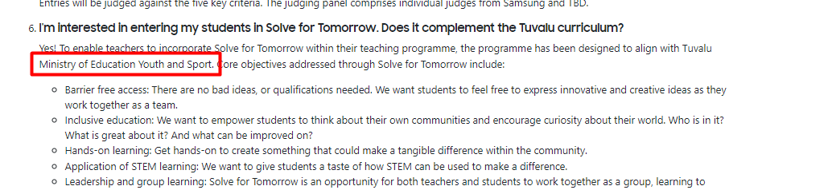
Ministry of Education and Human Resources Development (MEHRD)

Slide 12
Update all the TnCs links across the site

